Slide 1

Predicting Severity of Car Collisions in Seattle
By: Rama Chaitanya Samanchi
September 2020

Slide 2
Introduction

Slide 3
Phase 1: Business Understanding
Problem Statement
The objective of the project is to develop a model that can predict the severity of a car collision based on several important factors that influence a collision.
Background
For each accident taken place, the local traffic department of Seattle records each incident with a unique key and multiple factors related to the collision like the location, the number of people involved in, weather conditions, road conditions, light conditions, speeding, etc.
Target Stakeholders
1. Traffic government: mitigative actions to reduce car collisions
2. Emergency service provider and healthcare systems: provide necessary aid to potentially save the lives and improve the life- sensitivity

Slide 4
Data

Slide 5
Phase 2: Data Understanding
Dataset Description
1. Dataset is recorded by the traffic department of Seattle and available on the government site which is provided through Coursera
2. The dataset contains 194673 rows as the dataset captured the collision for multiple years i.e. from 2004 to 2020 (May).
3. The dataset has 37 columns which include description columns as well which will be dropped while building the model

Slide 6
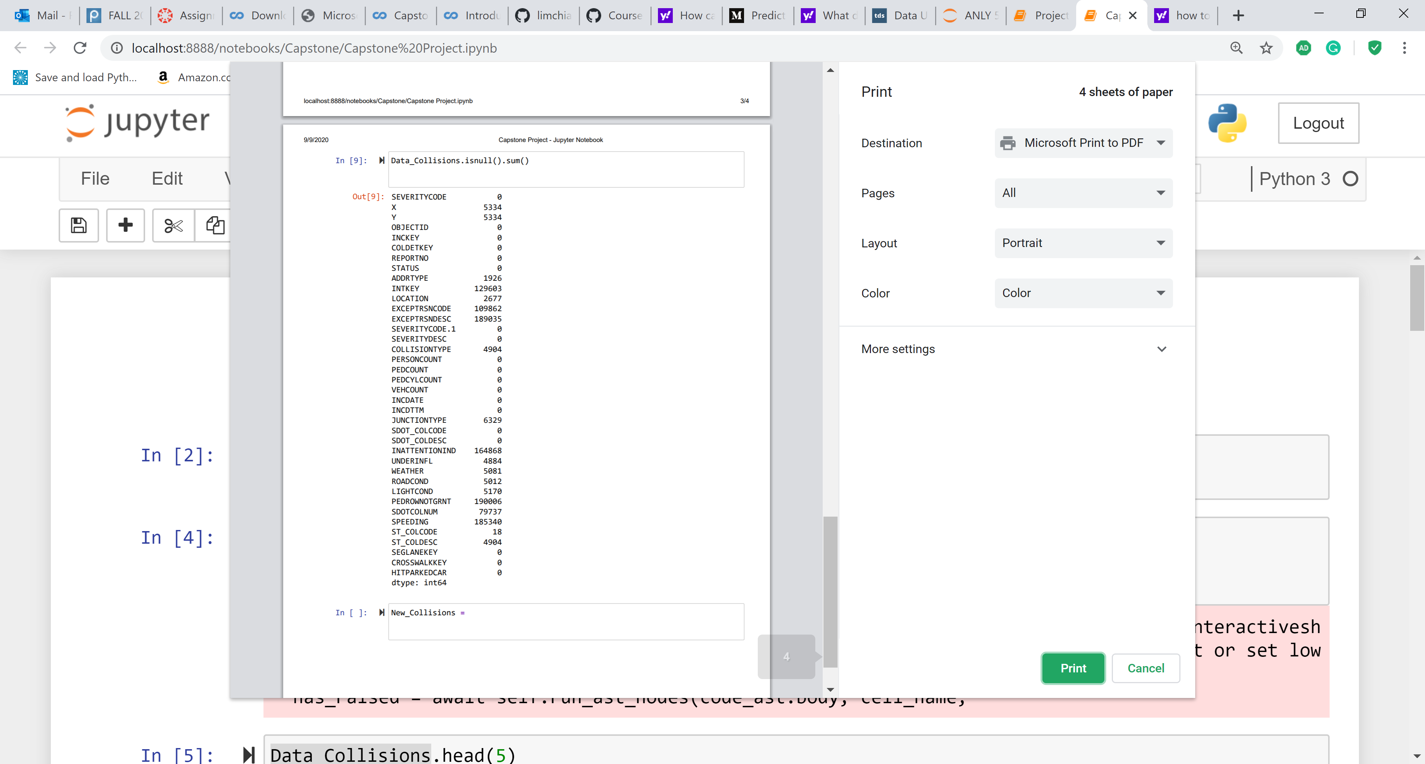
Phase 2: Data Understanding
Key pattern observations
These are the columns and their number of null values.

Slide 7
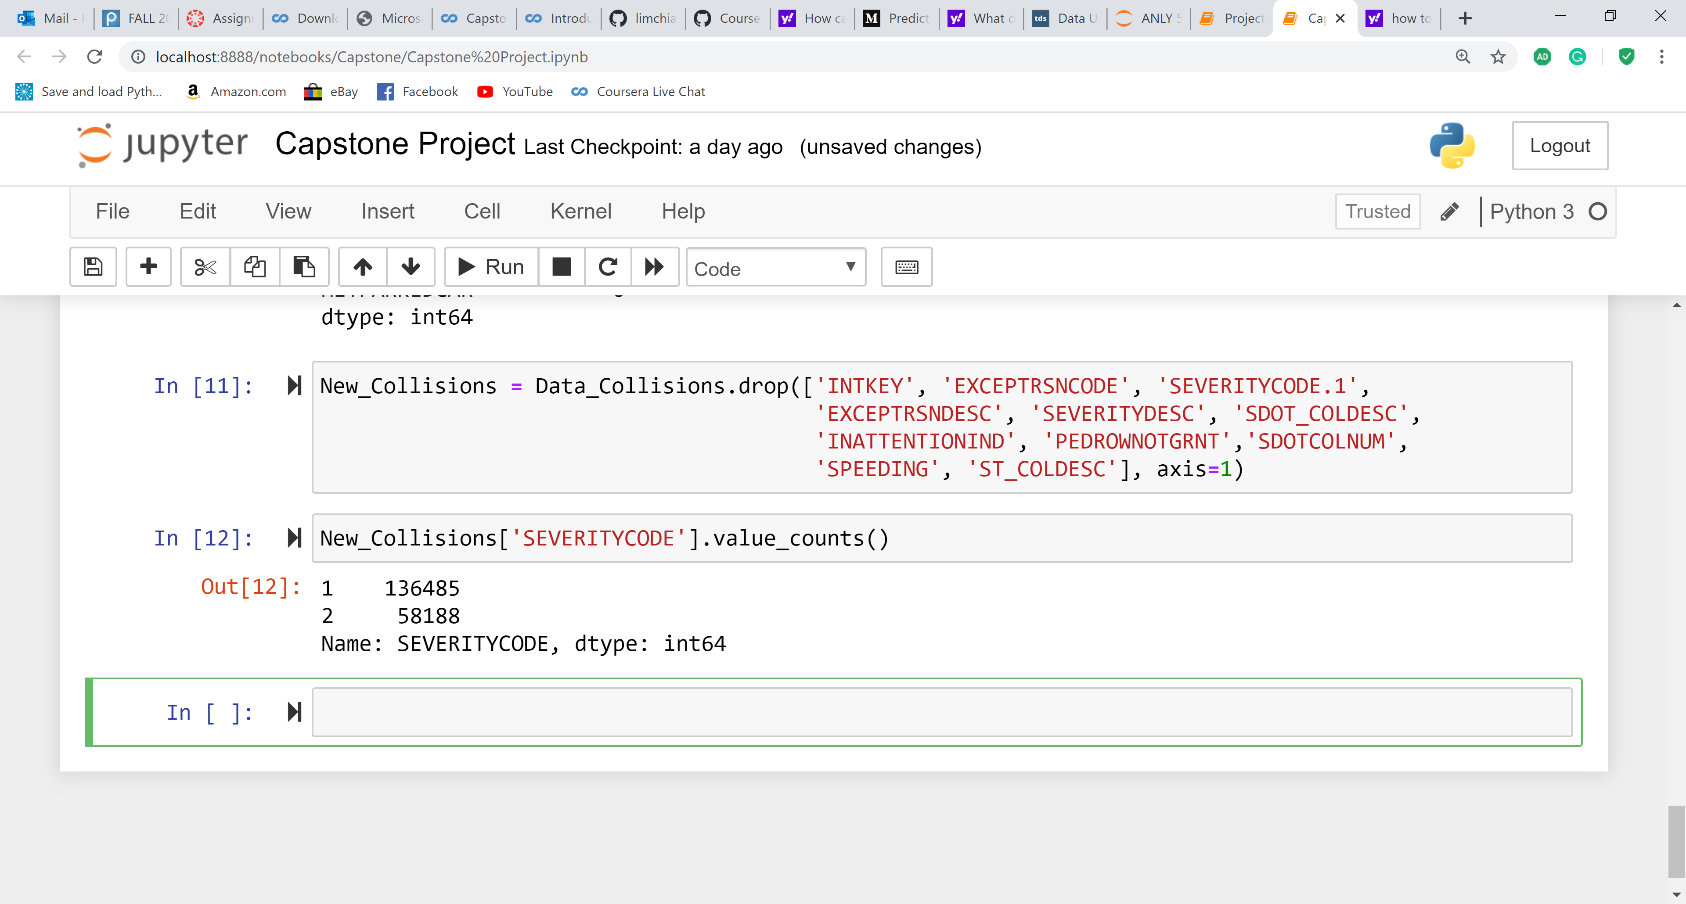
Phase 2: Data Understanding
Key pattern observations
2. Dropped some columns which are descriptions and have too many null values.
3. The Target variable Severity Code is imbalanced with two classifications 1 & 2.

Slide 8
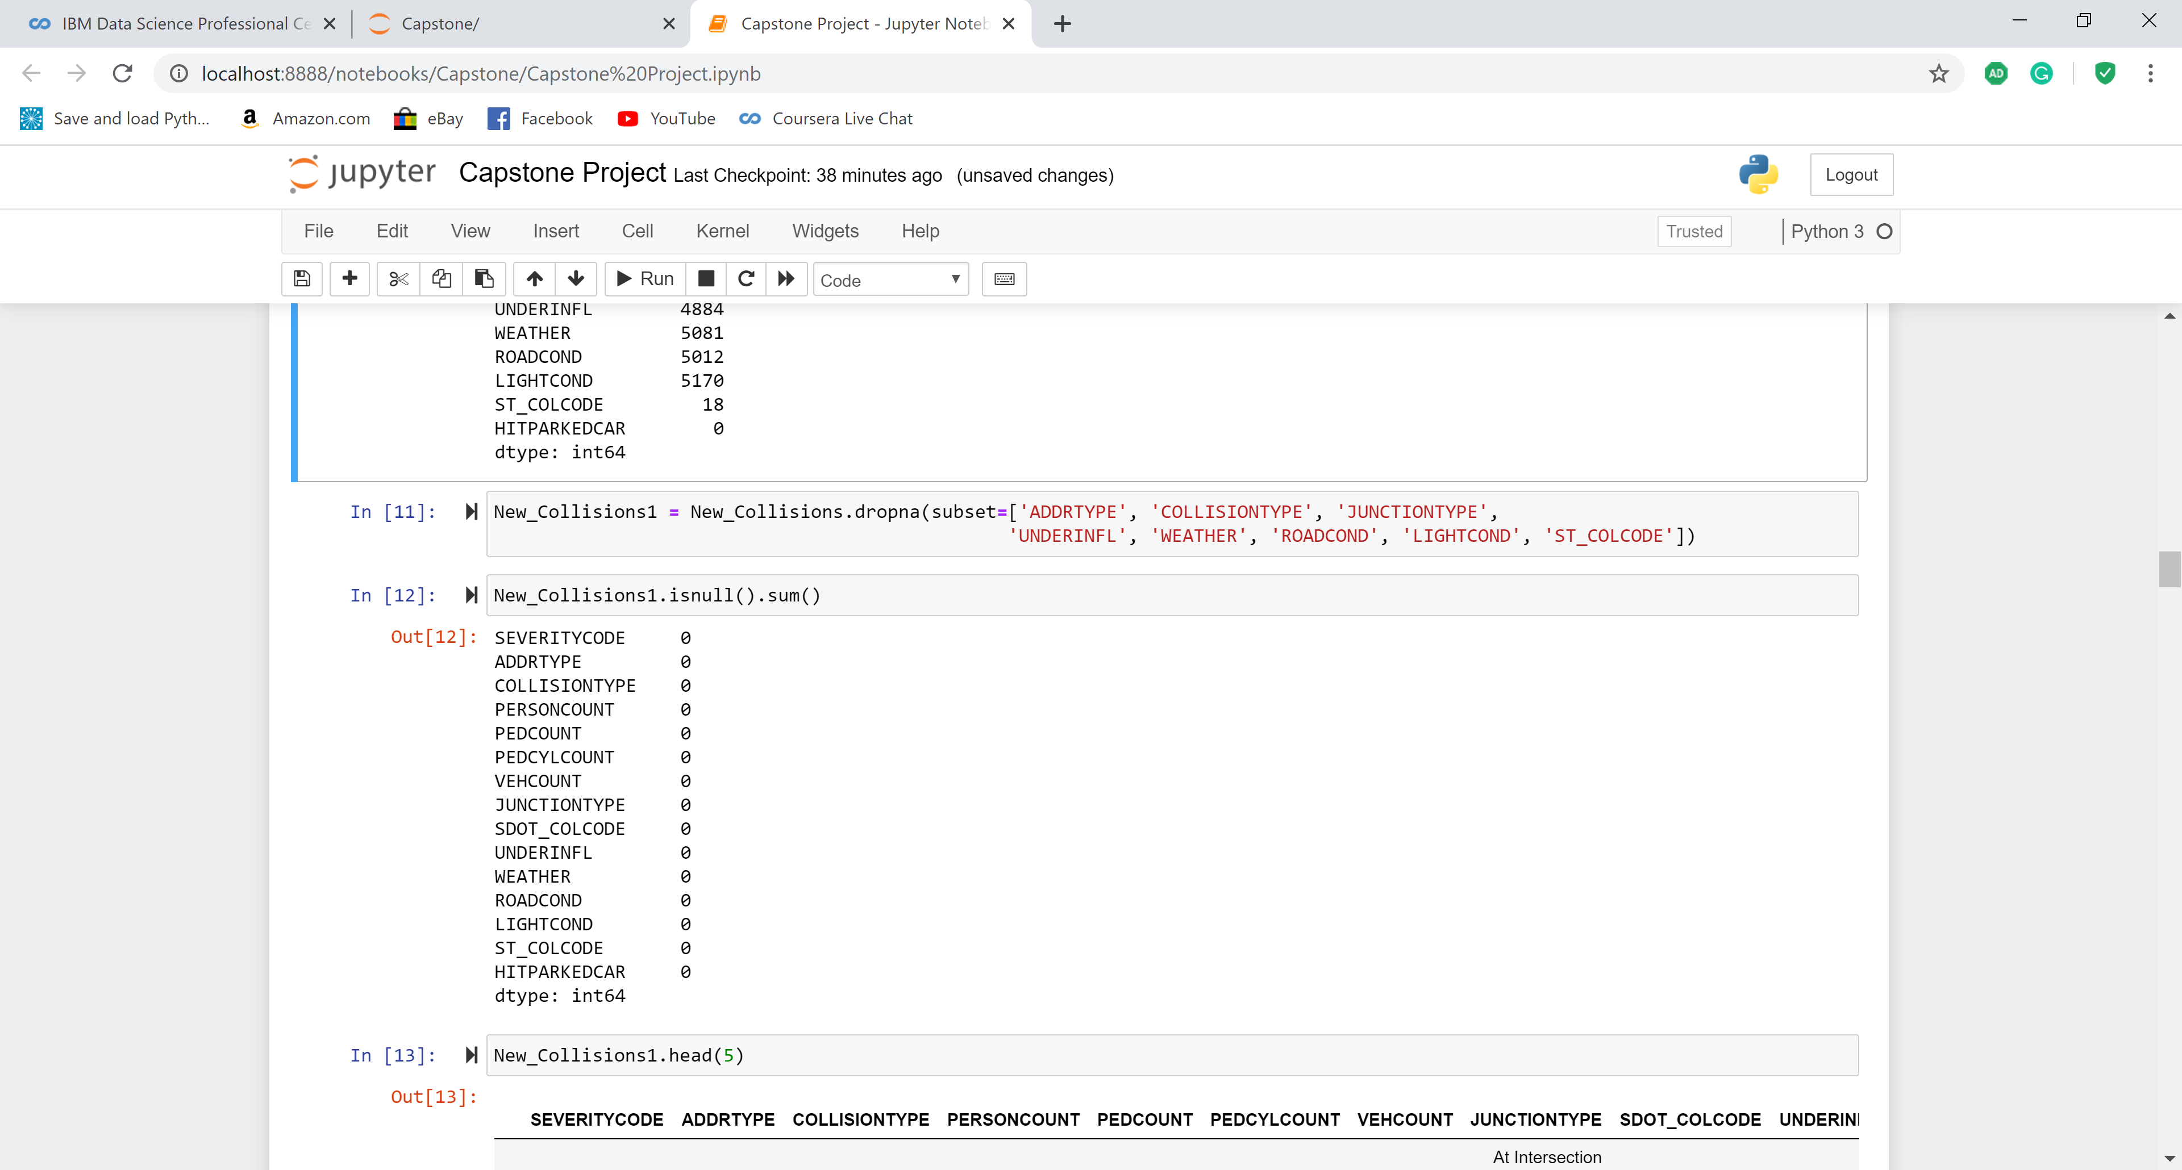
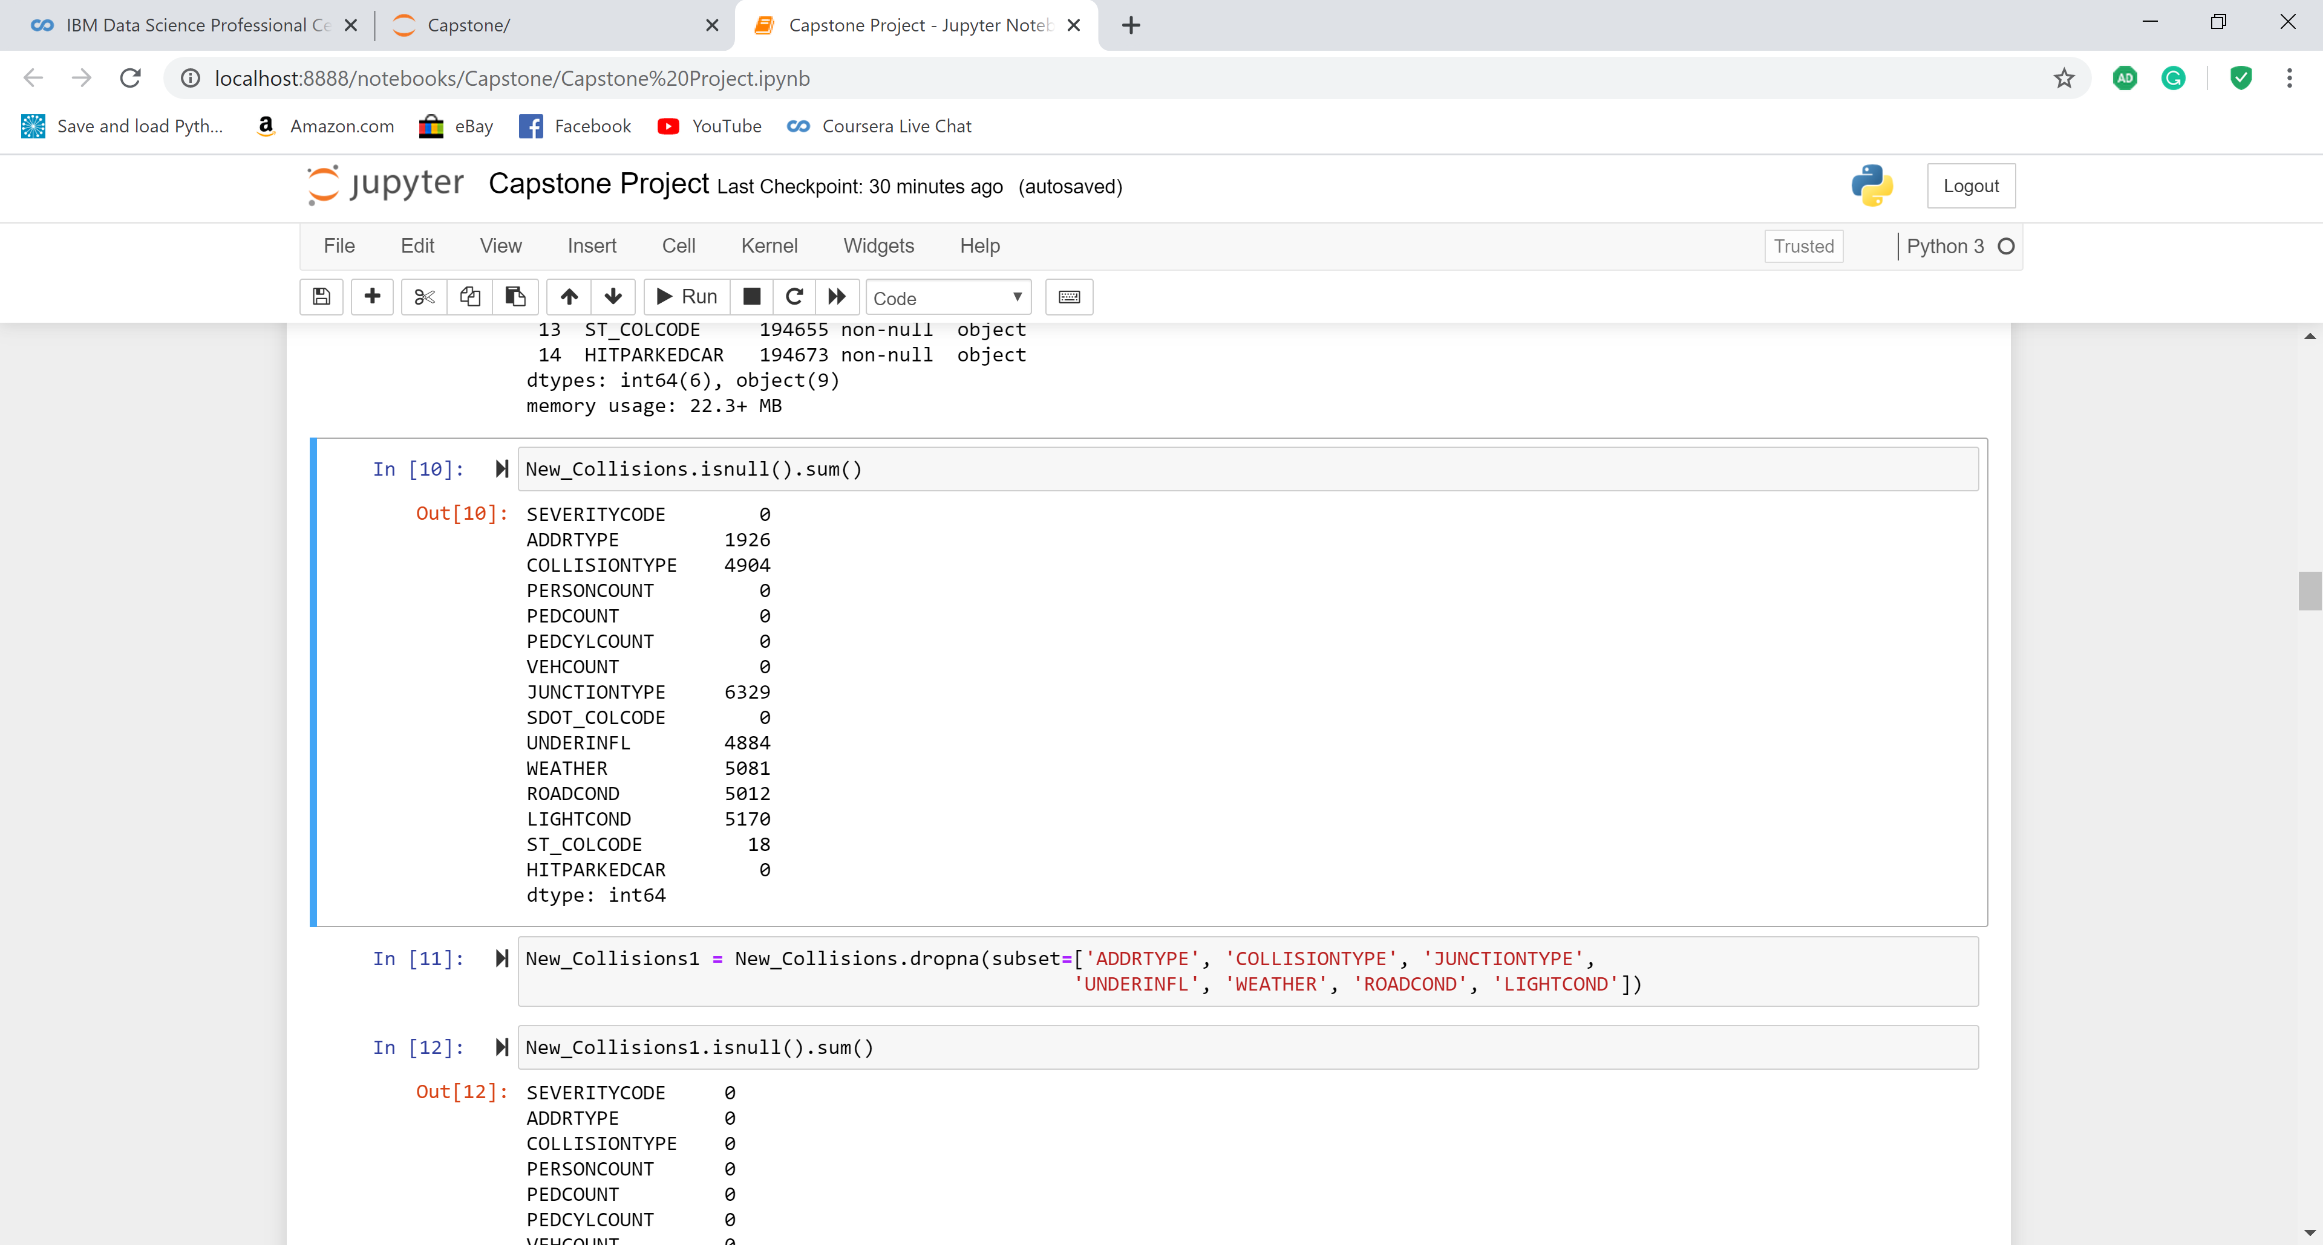
Phase 3: Data Preparation
1. Selection of columns
SEVERITYCODE, ADDRTYPE, COLLISIONTYPE, PERSONCOUNT, PEDCOUNT, PEDCYLCOUNT, VEHCOUNT , JUNCTIONTYPE, SDOT_COLCODE, UNDERINFL, WEATHER, ROADCOND, LIGHTCOND, ST_COLCODE, HITPARKEDCAR
2. Dropping null values
All the null values from the remaining columns have been dropped.

Slide 9
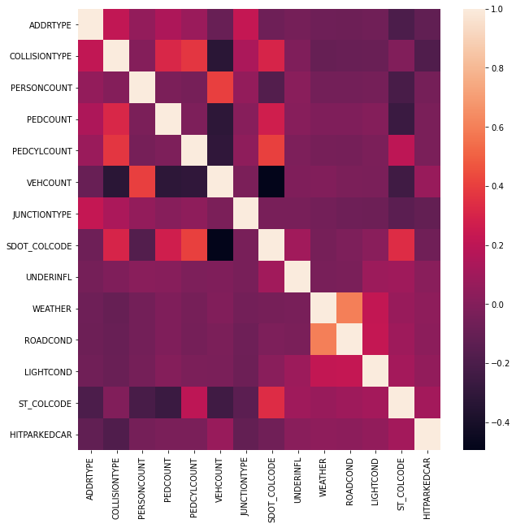
Phase 3: Data Preparation
3. Plotting heatmap for correlation between variables
All the 14 columns are plotted against each other on a heat map to check the correlation between them. The correlation is < 0.6 for all the combinations except for the diagonal comparisons, which means that there is no problem of multicollinearity in the dataset.

Slide 10
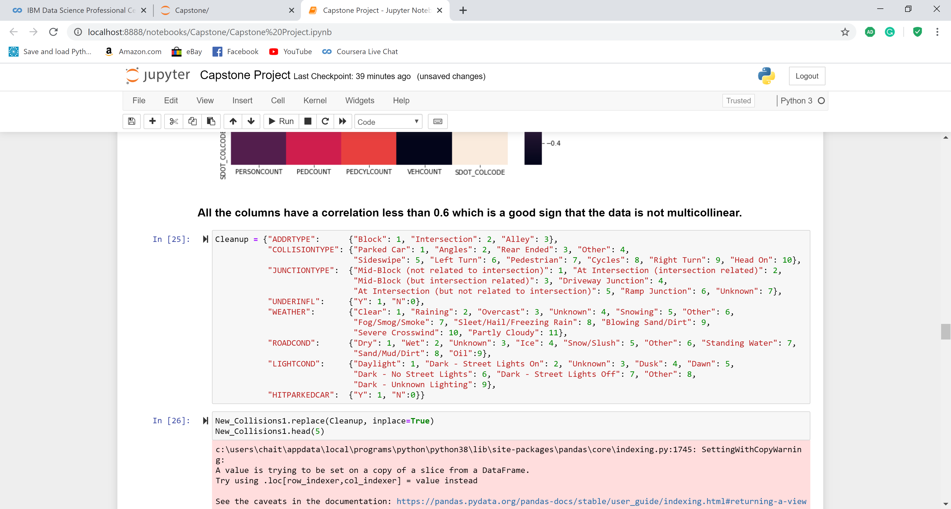
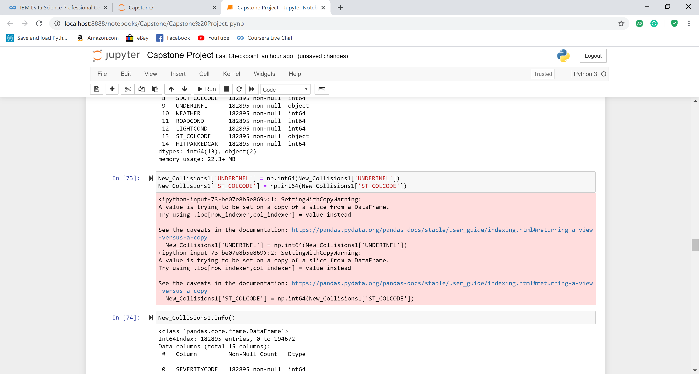
Phase 3: Data Preparation
4. Categorize some columns
All the categorical values of the columns are converted on a numerical scale for algorithmic purposes.
5. Change of Data Types
The datatypes of UNDERINFL & ST_COLCODE are converted into the integer type.

Slide 11
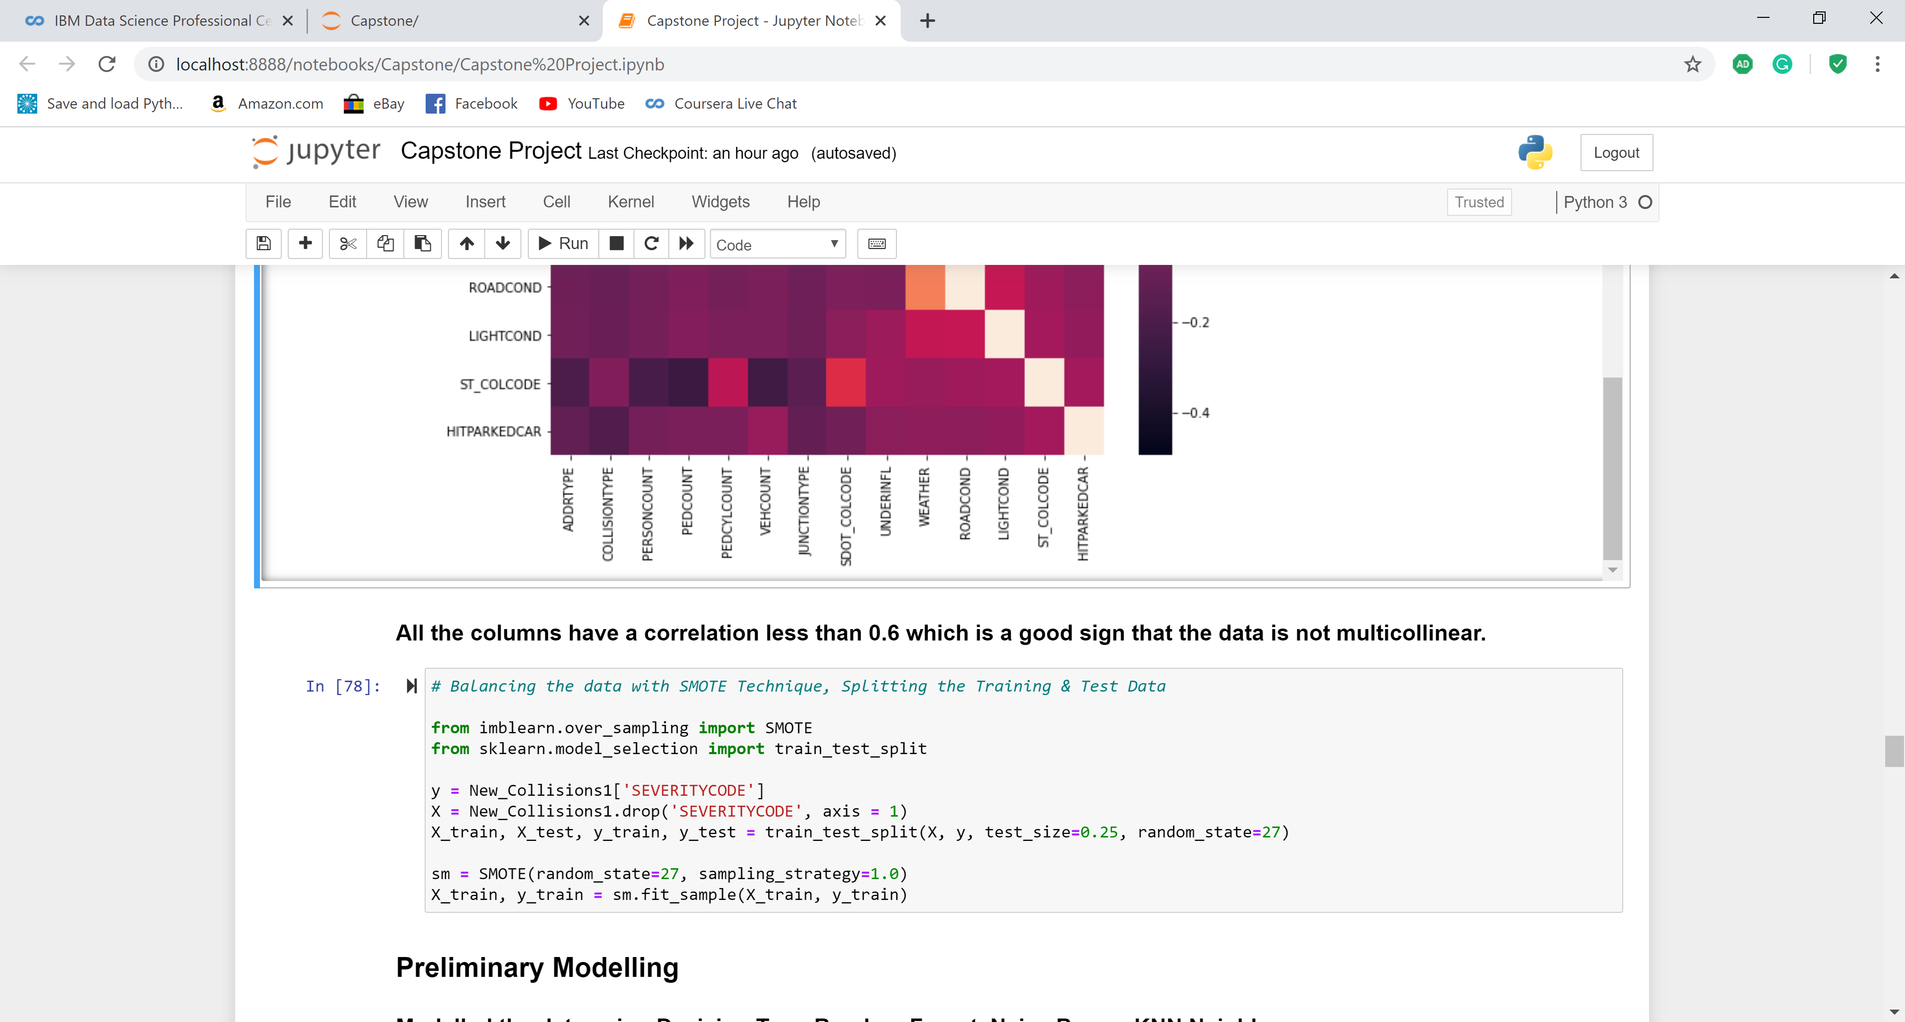
Phase 3: Data Preparation
6. Balancing the dataset to avoid overfitting issues
The Dataset needs to be balanced because the Target variable SEVERITYCODE is unbalanced across its categories. SMOTE Technique is employed to the same.
The Severity Code is defined as y (target variable) & the rest of the variables are assigned as the independent variables. The Training & Testing dataset split is set to 75:25.
This split is assigned to the SMOTE Sampling Strategy of 1.0.

Slide 12
Methodology

Slide 13
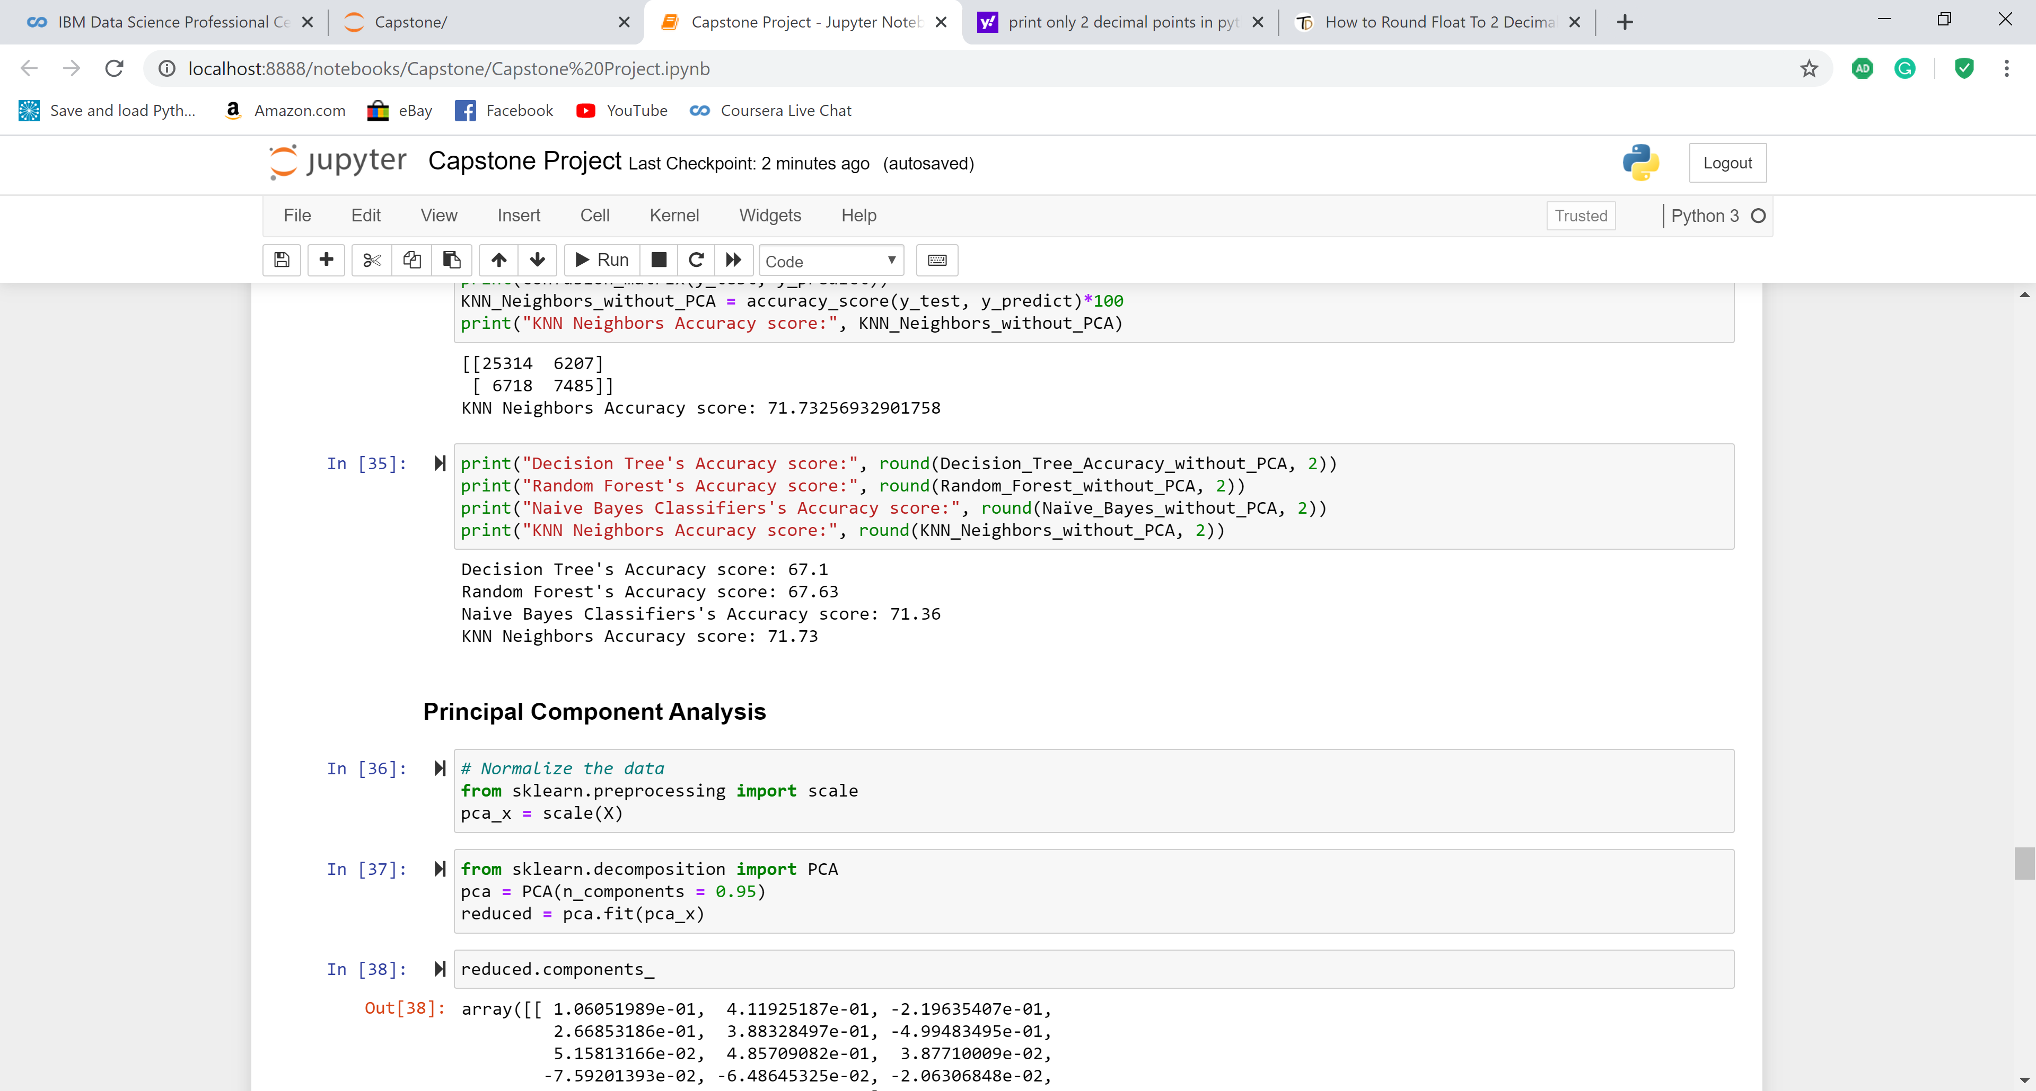
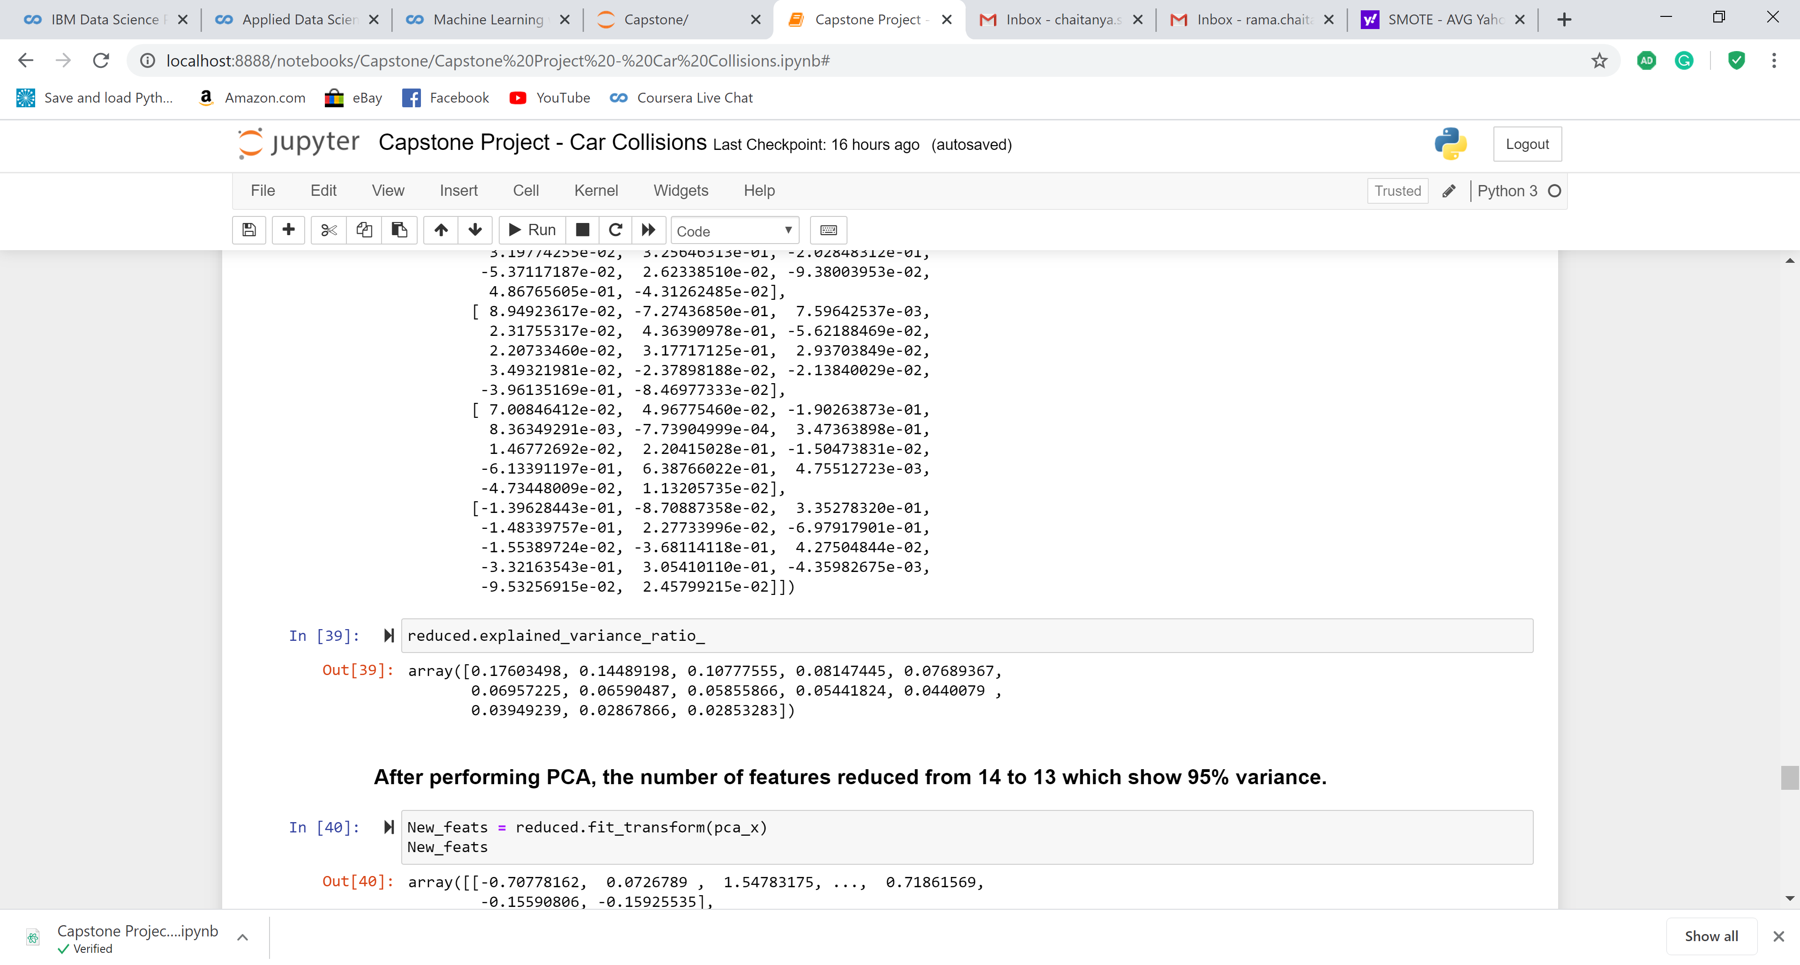
Phase 4: Modeling
1. Modeling without PCA
I have chosen 4 classification models: Decision Tree, Random Forest, Naïve Bayes, & KNN Neighbors to model the data and check the accuracy of each.
This modeling approach is conducted before performing Principal Component Analysis with all the 14 columns.
From the results below, it is evident that the KNN Neighbors model stands the best with an accuracy of 71.73%.
2. Principal Component Analysis
For an explained variance of 95%, the number of features reduced from 14 to 13. What the features are will be explained in the Evaluation phase.

Slide 14
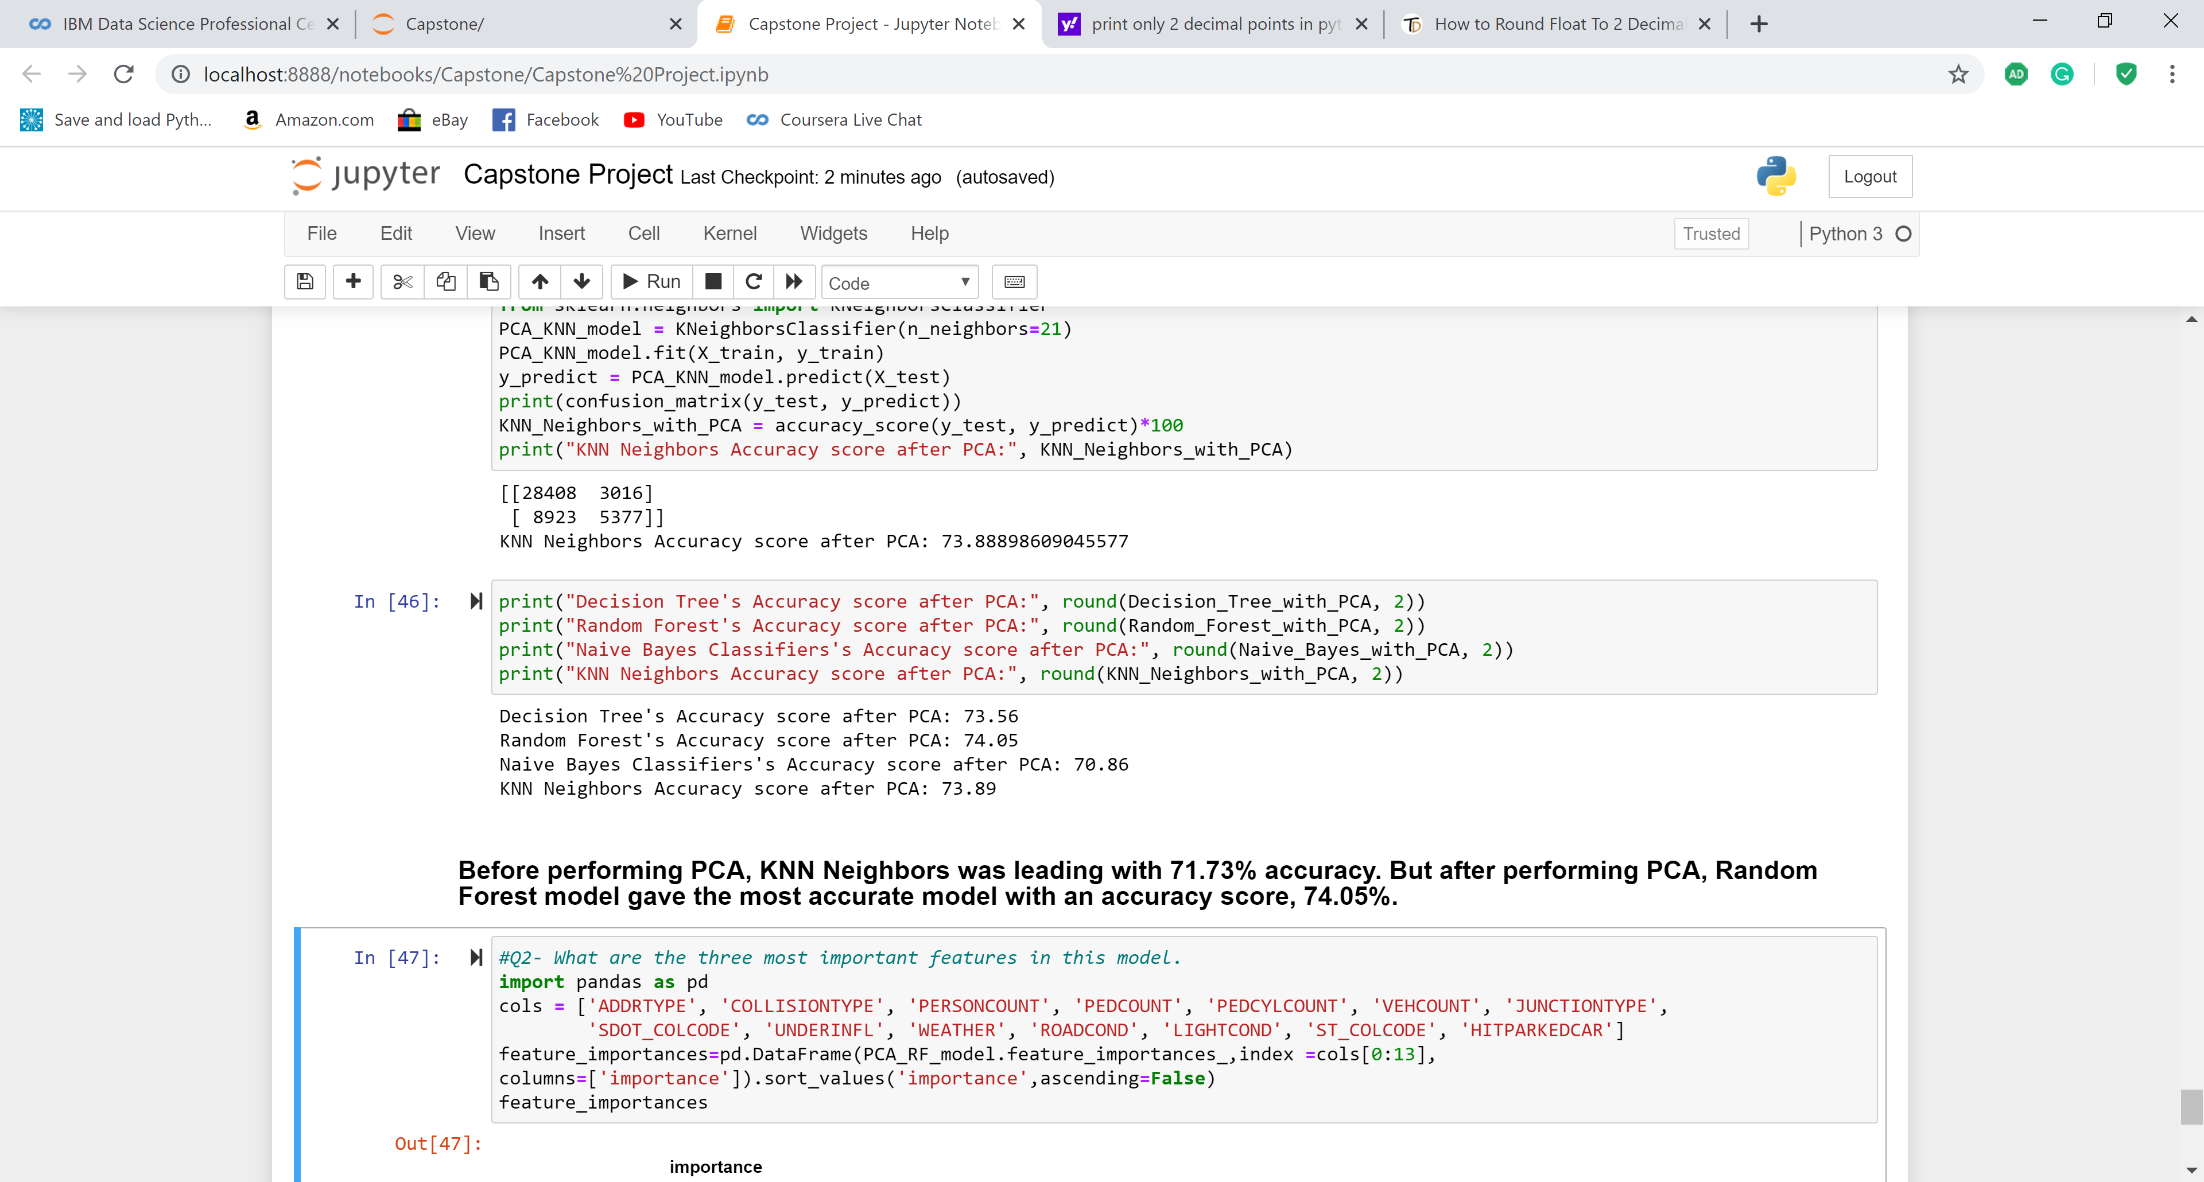
Phase 4: Modeling
3. Modeling with PCA
Models are generated on the dataset after PCA.
From the results below, Random Forest has the highest accuracy score of 74.05%.
This is the best model out of all the models presented so far.

Slide 15
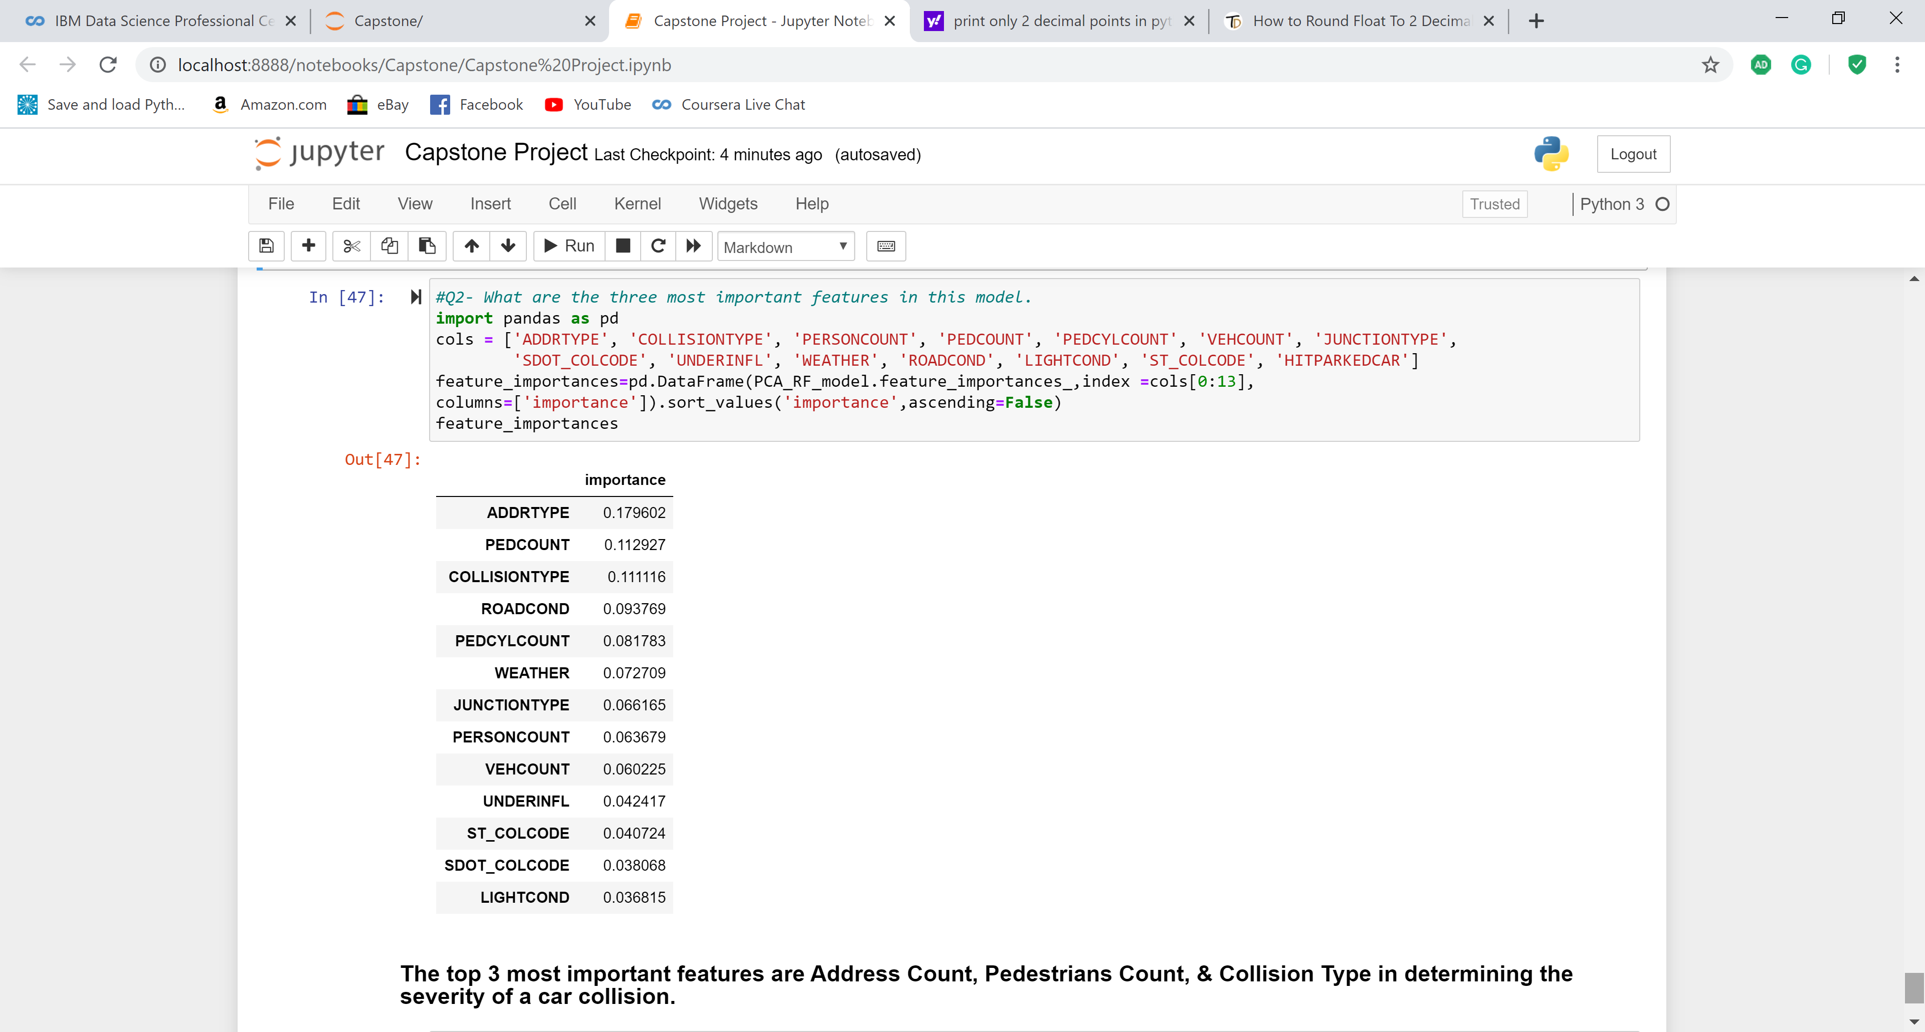
Phase 5: Evaluation
Feature Importance
ADDRTYPE, PEDCOUNT, & COLLISIONTYPE are the 3 most important features, which are explaining a 40% variance together.

Slide 16
Results
From the above study, we have created a working model based on the background of the problem which resulted in-
A Random Forest Model with an accuracy score of 74.05% built on 13 features
The three most important features of a car collision in Seattle are: Address Type, Pedestrians Count, and Collision Type

Slide 17
Discussion
Random Forest Model
It is very hard to find a model that yields higher accuracy for a social study
74% is reasonable very good accuracy of a learning model to predict the severity of a car collision
Further study & research of the factor’s affecting the severity of an incident will help us in predicting the severity at a higher rate
Feature Importance
ADDRTYPE is affecting the severity of a collision, as the address is a block, intersection, or alley can be very helpful in understanding the severity as they are guided by speed limits, the busyness of the area, and the probable angle of the collision.
PEDCOUNT is a good indicator of the number of pedestrians involved in the collision as they are the most vulnerable users of the streets.
The third and last most important factor is the Collision type itself. A head-on collision is more prone to severe damage rather than hitting a parked car. Hence, it is also a good indicator of the severity of the collision.

Slide 18
Conclusion
The findings of the project can serve as a very good start for the institutions like Traffic Department & Emergency Health Care Service Providers.
For example, based on the Address Type & Pedestrians injured, & Collision Type, the Health Care service Providers can make a firsthand estimate the severity of the collision as they explain 40% variance.
Also, the traffic department can utilize this model to start predicting the severity of an accident.

Slide 19
Thank You!

